Slide 1
MARKET STUCTURE

Slide 2
What is a Market?
The entire area where buyers and sellers of a commodity are in close contact and they have one price of same commodity.
Place where there are many buyers and sellers .
Actively engaged in buying and selling acts.
Contact through different means of communication like.

Slide 3
What is Market Structure?
those characteristics of a market that influence the behavior and interaction of buyers and sellers working in that market.
is best defined as the organizational and other characteristics of a market. These characteristics affect the nature of competition and pricing.

Slide 4
Type of market structure influences how a firm behaves:
Pricing
Supply
Barriers to Entry
Efficiency
Competition

Slide 5
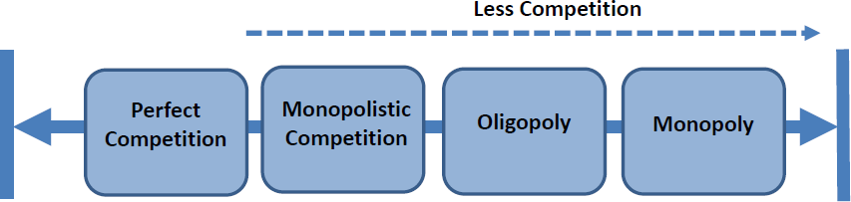
Market Structure Spectrum
Markets can be divided into categories depending on degrees of competition and market power.
Market structure is a function of:
No. of firms in the market.
The nature of the product – differentiated (heterogeneous) or undifferentiated (homogenous).
Extent of information available to market participants.
Freedom of entry and exit, existence of barriers to entry.

Slide 6
Forms of Market
Perfect competition
monopolistic competition
oligopoly
monopoloy

Slide 7
1. PERFECT COMPETITION
is a market structure where an infinitely large number of buyers and sellers operate freely and sell a homogeneous commodity at a uniform price.
Examples of perfect competition:
Financial markets – stock exchange, currency markets, bond markets?
Agriculture?

Slide 8
Features of Perfect Competition
Free entry and exit to industry
Homogenous product – identical so no consumer preference
Large number of buyers and sellers – no individual seller can influence price
Sellers are price takers – have to accept the market price
Perfect information available to buyers and sellers

Slide 9
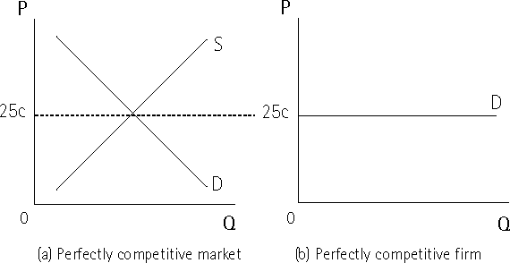
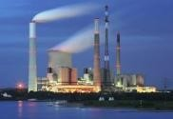
The perfectly competitive market
The fact that firm is a price taker has import implications for the shape of the demand curve the firm faces.
Apples on Moore street are 25c each.
At the market level, price is determined as normal (intersection of demand and supply)
Individual seller faces horizontal demand curve; can sell as much as like at 25c, will neither increase nor reduce price.

Slide 10
In a perfectly competitive market marginal revenue (MR) is equal to price (P) and average revenue (AR).
Example: Firm does not have to lower price to sell more.
Qty | Price | TR | MR | AR
0 | 10 | - | - | -
1 | 10 | 10 | 10 | 10
2 | 10 | 20 | 10 | 10
3 | 10 | 30 | 10 | 10
4 | 10 | 40 | 10 | 10
8

Slide 11
Average Revenue (AR) Curve is also a Demand Curve facing a perfectly competitive firm, which is perfectly elastic.
Marginal revenue (MR) The change in total revenue from the sale of one additional unit of output.

Slide 12
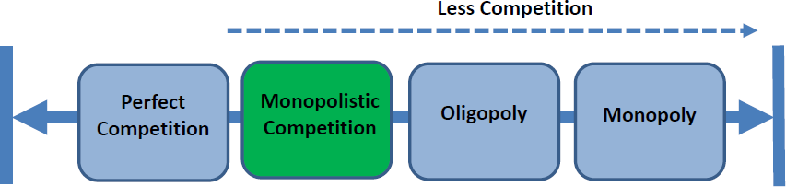
Monopolistic Competition

Slide 13
2. Monopolistic Competition
Monopolistic competition is a situa-tion in which the market, basically, is a competitive market but has some elements of a monopoly. In this form of market there are many firms that sell closely differentiated products.
The examples of this form of market are Mobiles, Cosmetics, Detergents, Toothpastes etc.

Slide 14
Features of Monopolistic Competition
Imperfect or Monopolistic Competition
Many buyers and sellers
Products differentiated
Relatively free entry and exit
Each firm may have a tiny ‘monopoly’ because of the differentiation of their product
Firm has some control over price

Slide 15
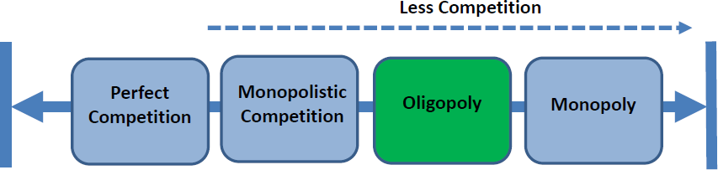
Oligopoly

Slide 16
3. Oligopoly
The term Oligopoly means ‘Few Sellers’. An Oligopoly is an industry composed of only few firms, or a small number of large firms producing bulk of its output.
Examples of oligopolistic structures:
Supermarkets
Banking industry
Chemicals
Oil
Medicinal drugs
Broadcasting

Slide 17
Features of Oligopoly
Industry dominated by small number of large firms
Many firms may make up the industry
High barriers to entry
Products could be highly differentiated – branding or homogenous
Non–price competition
Price stability within the market
Potential for collusion?
Abnormal profits
High degree of interdependence between firms

Slide 18
Collusion is formal agreement between sellers to set specific prices or to otherwise behave in a cooperative manner (For example, OPEC = Organization of the Petroleum Exporting Countries).
Price-fixing is a form of collusion where firms establish the price of a product or service, rather than allowing it to be determined naturally through free market

Slide 19
Measuring Oligopoly:
Concentration ratio – the proportion of market share accounted for by top X number of firms:
E.g. 5 firm concentration ratio of 80% - means top 5 five firms account for 80% of market share
3 firm CR of 72% - top 3 firms account for 72% of market share

Slide 20
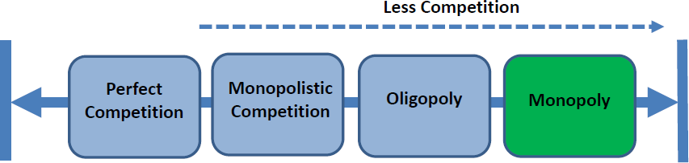
Monopoly
15

Slide 21
What is monopolistic firm
A single firm having full control over the production and the supply of a commodity.
There is no close substitute of the product in the whole market.
New entry in the business is not possible.
Monopolist can effect the price as there is no other firm in the market.

Slide 22
Causes of monopoly
Monopoly come into existence due to many reasons
Natural resources
Some countries have specific climatic conditions, characteristics of soil and mineral resources for the production of particular goods. E.g. jute of Subcontinent, coffee of Brazil etc.
Social welfare
For many economic activities the competition is regarded wasteful. For the welfare and benefit of the members of society such a competition may be avoided while creating monopoly e.g. WAPDA dept. in Pakistan.

Slide 23
Patent and copy right
An inventor, innovating firm, author of book etc. may be granted patent and copy rights by legal authority. No other person can utilize it.
Technical know how
Some time the firm has special know how or exclusive knowledge of production techniques about production of commodity. E.g. F16 of USA.
Unity among entrepreneurs
Some times monopolies are also created when some entrepreneurs agree upon some open or secret formula regarding the sale or price of the commodity. Such an agreement may be seen in the form of cartel etc.

Slide 24
Heavy and costly projects
There are some production fields where initial cost of project is very heavy and even out of reach of many firms. Thus the firm who dares to enter the field may enjoy the monopoly power e.g. Natural gas field.

Slide 25
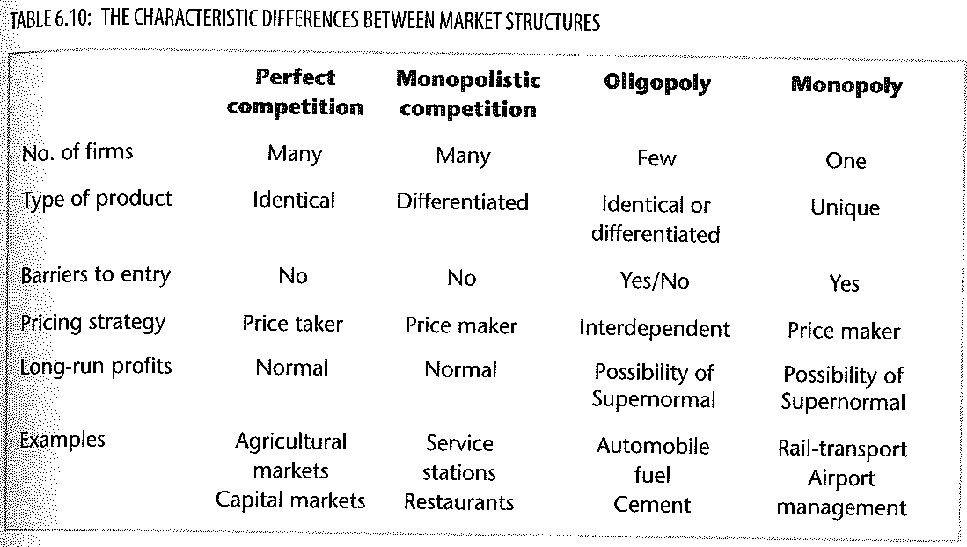
Summary

